Slide 3
EM-III PROJECT ON FITTING OF EXPONENTIAL CURVE :
PRESENTATION BY :
NAMES : ROLL.NO :
SHREYA VIJAYKUMAR MOHITE - 33
TEJAL SUNIL MAHAJAN - 29
TEJASWINI PANDURANG KACHARE - 26

Slide 4
INTRODUCTION:
WHAT IS FITTING OF EXPONENTIAL CURVE ?
The data fit in an exponential function.
The data points appear to fit the curve close to Perfectly, so the relationship can be described as very strong .
As time increases ,the number of customers increases ,so the relationship can be described as positive .

Slide 5
DEFINITION:
Curve Fitting is the process of constructing a curve , or mathematical function , that has the best fit to a series of data points , possibly subject to constraints .
It is a statistical technique use to drive coefficient values for equations that express the value of one { dependent } variable as a function of another { independent variable } .

Slide 6
Method of least squares ↪
The method of least squares helps us to find the values of unknowns a and b in such a way that the following two conditions are satisfied:
The sum of the residual (deviations) of observed values of Y and corresponding expected (estimated) values of Y will be zero. ∑(Y–Yˆ)=0.
The sum of the squares of the residual (deviations) of observed values of Y and corresponding expected values (Yˆ) should be at least ∑(Y–Yˆ)2.

Slide 7

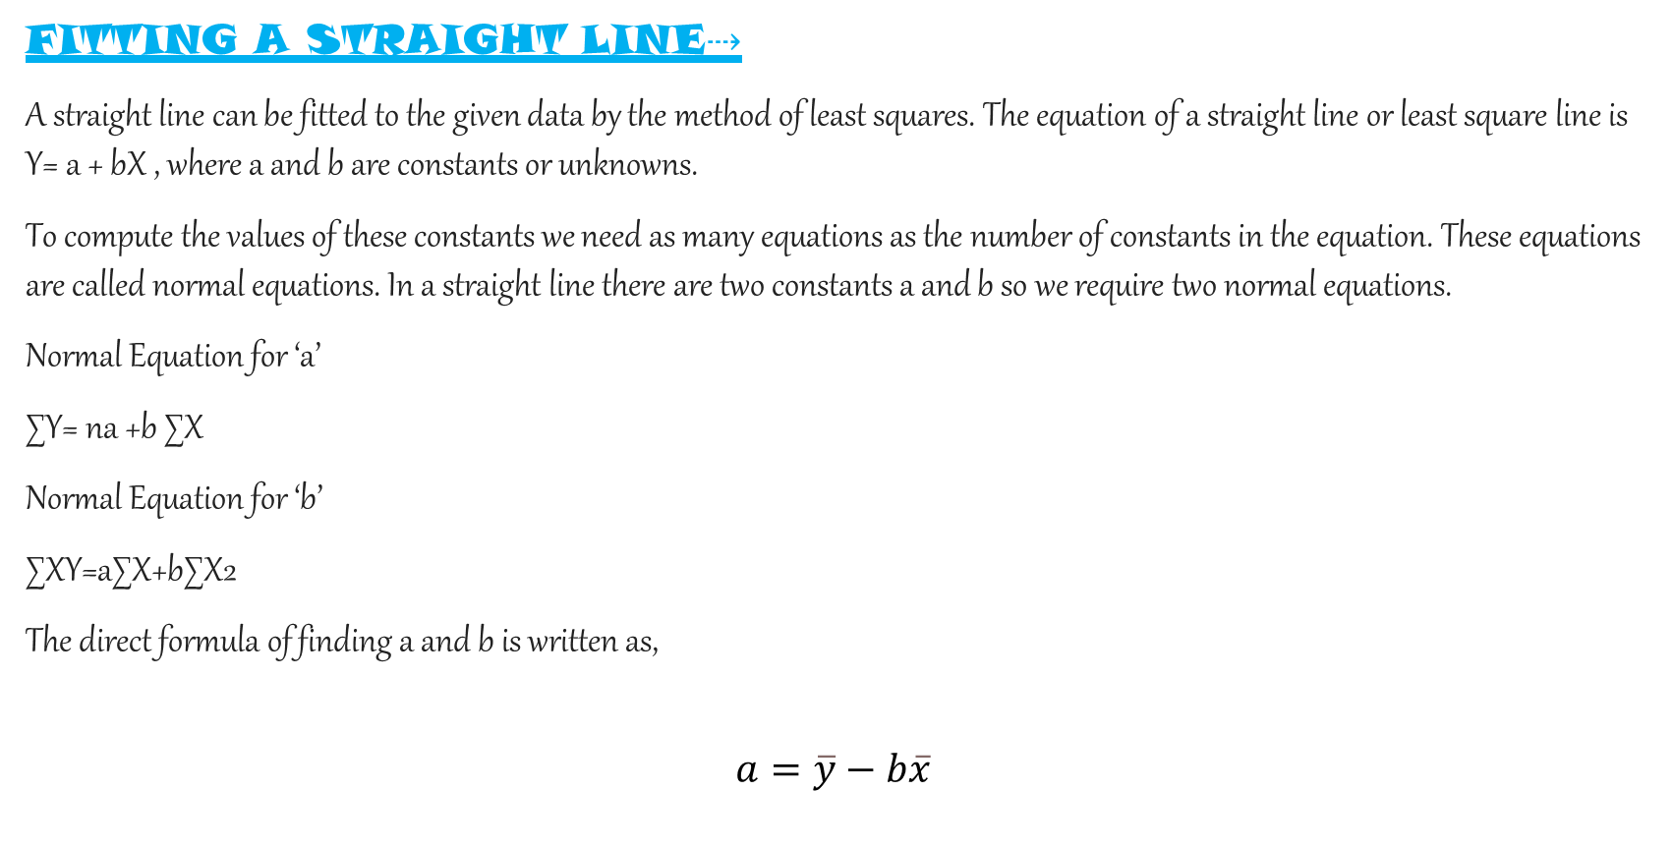
FITTING A STRAIGHT LINE⇢
A straight line can be fitted to the given data by the method of least squares. The equation of a straight line or least square line is Y= a + bX , where a and b are constants or unknowns.
To compute the values of these constants we need as many equations as the number of constants in the equation. These equations are called normal equations. In a straight line there are two constants a and b so we require two normal equations.
Normal Equation for ‘a’
∑Y= na +b ∑X
Normal Equation for ‘b’
∑XY=a∑X+b∑X2
The direct formula of finding a and b is written as,
$$a=\overline{y}−b\overline{x}$$
$$b=\frac{\sum{xy}−\frac{\left(\sum{x}\right)\left(\sum{y}\right)}{n}}{\sum{x^{2}}−\frac{{\left(\sum{x}\right)}^{2}}{n}}$$

Slide 8
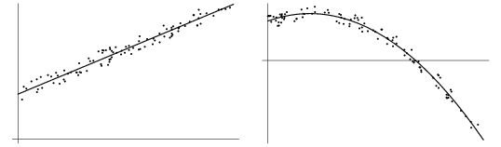
Suppose we have a set of values [ X,Y ] and further that we want to fit a straight line y = a +bx to these values. The straight line must be close to the given points to the maximum extent . The principle of least square states that the straight line should be such that the distances of the given points from the straight line measured along the y-axis must be minimum . The line obtained in this way is called the line of best fit .

Slide 9
Example on fitting a straight line⇢
Problem no 1 :
Q} fit a straight line y = a +bx to the following data .
SOLUTION : calculations of ∑ x, ∑ x^2 .
x | 0 | 5 | 10 | 15 | 20 | 25
y | 12 | 15 | 17 | 22 | 24 | 30

Slide 10
Let the given table be ,
x | y | X^2 | xy
0 | 12 | 0 | 0
5 | 15 | 25 | 75
10 | 17 | 100 | 170
15 | 22 | 225 | 330
20 | 24 | 400 | 480
25 | 30 | 625 | 750
N=6 , ∑ x = 75 | ∑ y = 120 | ∑ x^2 = 1375 | ∑ xy = 1805

Slide 11
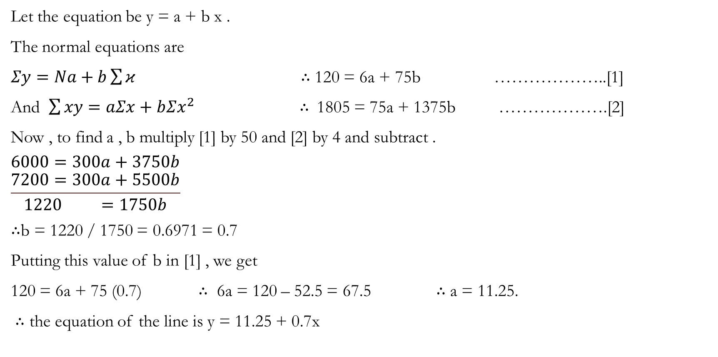
Let the equation be y = a + b x .
The normal equations are
$Σy=Na+b\sum{κ}$ ∴ 120 = 6a + 75b ………………..[1]
And $\sum{xy}=aΣx+bΣx^{2}$ ∴ 1805 = 75a + 1375b ……………….[2]
Now , to find a , b multiply [1] by 50 and [2] by 4 and subtract .
$$\begin{matrix}6000=300a+3750b \\ \frac{7200=300a+5500b}{1220 =1750b}\end{matrix}$$
∴b = 1220 / 1750 = 0.6971 = 0.7
Putting this value of b in [1] , we get
120 = 6a + 75 (0.7) ∴ 6a = 120 – 52.5 = 67.5 ∴ a = 11.25.
∴ the equation of the line is y = 11.25 + 0.7x

Slide 12
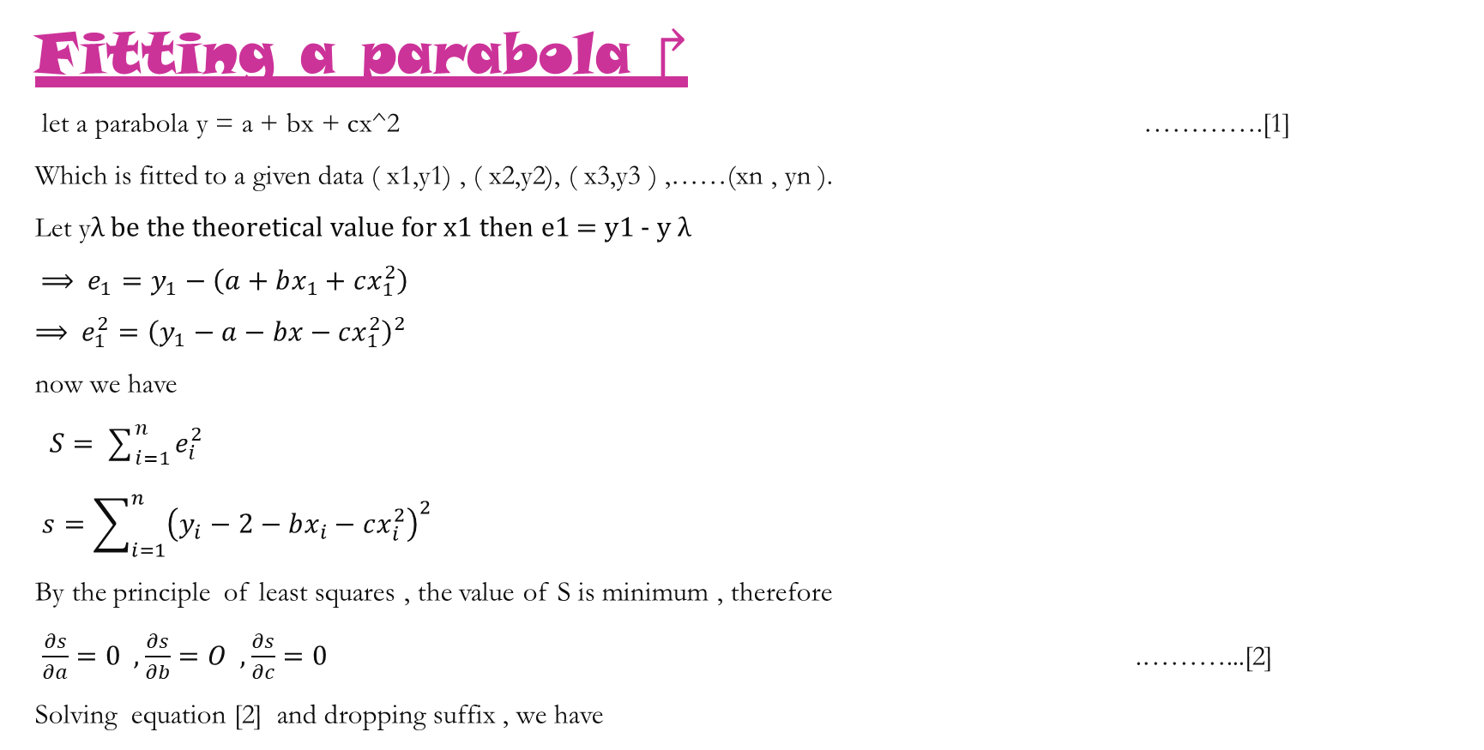
Fitting a parabola ↱
let a parabola y = a + bx + cx^2 ………….[1]
Which is fitted to a given data ( x1,y1) , ( x2,y2), ( x3,y3 ) ,……(xn , yn ).
Let yλ be the theoretical value for x1 then e1 = y1 - y λ
⟹ $e_{1}=y_{1}−\left(a+bx_{1}+cx_{1}^{2}\right)$
⟹ $e_{1}^{2}={\left(y_{1}−a−bx−cx_{1}^{2}\right)}^{2}$
now we have
$S=\sum_{i=1}^{n}{e_{i}^{2}}$
$s=\sum_{i=1}^{n}{{\left(y_{i}−2−bx_{i}−cx_{i}^{2}\right)}^{2}}$
By the principle of least squares , the value of S is minimum , therefore
$\frac{∂s}{∂a}=0 , \frac{∂s}{∂b}=O , \frac{∂s}{∂c}=0$ .………...[2]
Solving equation [2] and dropping suffix , we have

Slide 13
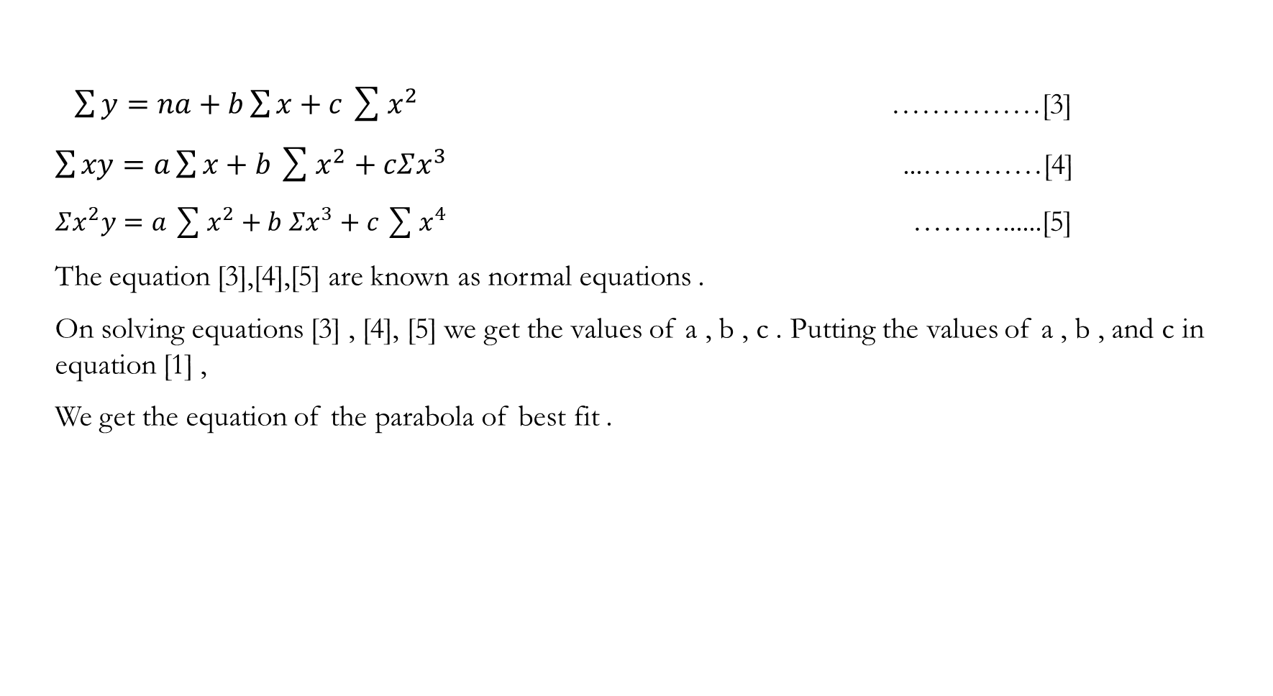
$\sum{y}=na+b\sum{x}+c\sum{x^{2}}$ ……………[3]
$\sum{xy}=a\sum{x}+b\sum{x^{2}}+cΣx^{3}$ ...…………[4]
$Σx^{2}y=a\sum{x^{2}}+b Σx^{3}+c\sum{x^{4}}$ ………......[5]
The equation [3],[4],[5] are known as normal equations .
On solving equations [3] , [4], [5] we get the values of a , b , c . Putting the values of a , b , and c in equation [1] ,
We get the equation of the parabola of best fit .

Slide 14
Suppose we have a set of values [ x, y ] and further that we want to fit a parabola y = a+ b x + cx^2 to these values .
The parabola must be close to the given points as much as possible .
the principle of least squares states that the
parabola should be such that the distances of the
given points from the parabola measured along the
y – axis must be minimum .

Slide 15
Example on fitting a parabola ↱
Problem no 1 :
Q } by the method of least squares find the best values of a , b , c in the law y = a + bx + cx^2 to fit the following data .
solution :
X | -2 | -1 | 0 | 1 | 2
y | -3.150 | -1.390 | 0.620 | 2.880 | 5.378

Slide 16
Calculations of Σ x , Σ y , Σ x^2
Sr.no | x | y | X^2 | X^3 | X^4 | X y | X^2y
1 | -2 | -3.150 | 4 | -8 | 16 | 6.300 | -12.600
2 | -1 | -1.390 | 1 | -1 | 1 | 1.390 | -1.390
3 | 0 | 0.620 | 0 | 0 | 0 | 0.000 | 0.000
4 | 1 | 2.880 | 1 | 1 | 1 | 2.880 | 2.880
5 | 2 | 5.378 | 4 | 8 | 16 | 10.756 | 21.512
N = 5 | 0 | 4.338 | 10 | 0 | 34 | 21.326 | 10.402

Slide 17
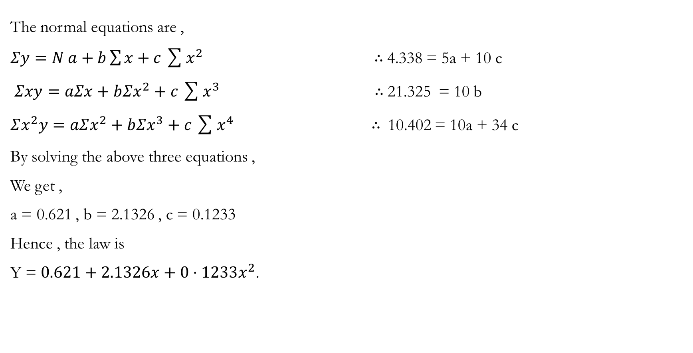
The normal equations are ,
$Σy=N a+b\sum{x}+c\sum{x^{2}}$ ∴ 4.338 = 5a + 10 c
$Σxy=aΣx+bΣx^{2}+c\sum{x^{3}}$ ∴ 21.325 = 10 b
$Σx^{2}y=aΣx^{2}+bΣx^{3}+c\sum{x^{4}}$ ∴ 10.402 = 10a + 34 c
By solving the above three equations ,
We get ,
a = 0.621 , b = 2.1326 , c = 0.1233
Hence , the law is
Y = $0.621+2.1326x+0⋅1233x^{2}$.

Slide 18
FITTING EXPONENTIAL CURVE ↠
If we have to fit an exponential curve of the form y=ax^b or y=ab^x or y=ae^x , we take logarithm of both sides. Then the given exponential equation transforms into a linear equation. We then use the above technique
Suppose the law as y = ab^x
Taking logarithm of both sides to the base 10, we get
Log 10 y= log 10 a+x log 10 b
Putting log10 y=Y, log10 a =A, x=X, log 10 b = B, we get
Y = A + BX
This is, a linear equation in X and Y and we can obtain the constants A and B . And resubstituting for A and B, we can obtain the equation y = ab^x .
If the law is y = ax^b taking logarithm of both sides, we get
log y = log a + b log x.
Putting log y = Y, log a = A, b = B and log x = X, we get
Y = A + BX.

Slide 19
Example on fitting of exponential curve ↠
PROBLEM NO 1 :
Q}Fit a curve y = a e^bx to the following data , using the method of least squares.
SOLUTION : taking logarithms of y = a e ^bx , we get log y = log a +bx . Let us put log y = Y and log a = A. then the law becomes Y=A+BX.
X | 0 | 2 | 4
Y | 8.12 | 10 | 31.82

Slide 20
CALCULATING ∑X , ∑Y :
x | y | Y=log y | x Y | x^2
0 | 8.12 | 2.0943 | 0 | 0
2 | 10 | 2.3026 | 4.6052 | 4
4 | 31.82 | 3.6041 | 13.8404 | 16
Σx = 6 |  | ΣY = 7.8570 | Σx Y = 18.445 | Σx^2 = 20

Slide 21
Now , we have
ΣY = NA+ B ΣX
=> 7.8570 = 3A+ 6b
ΣXY = A ΣX + B ΣX^2
=> 18.4426 = 6A + 20b
Solving the above two equations , we get
A = 1.9361 & B = 0.3415
Hence ,
a = antilog [ 1.9361 ]
∴ a = 6.9317
∴ This law is y = [ 6.9317 ] e^0.3415x

Slide 22
APPLICATIONS : - >
Curve fitting examines the relationship between one or more predictors { independent variables } and a response variables { dependent variables } , with the goal of dealing a “ best fit “ model of the relationship .
fitted curves can be used as an aid for data visualization , to infer vales of a function where no data are available , and to summarize the relationships among two or more variables .
curves such as parabola and hyperbola are used in architecture to design arches in building . They are known to be theoretically the strongest form of arches and commonly used in architectural design .

Slide 23
exponential functions are used to model populations , carbon date artifacts , help coroners determine time to death , compute investments , as well as many applications .

Slide 24
CONCLUSION →

Slide 26
REFERENCES ➔

Slide 27



